Slide 1
Lecture 20: Root Locus for Design
Controller Design with Root Locus Overview
Translate performance specifications into closed-loop pole locations
Draw root locus of system with simple gain K
See if a gain change can meet your requirements
If not, then add poles and/or zeros via the controller to reshape the root locus to pass through the desired closed-loop pole locations

Slide 2
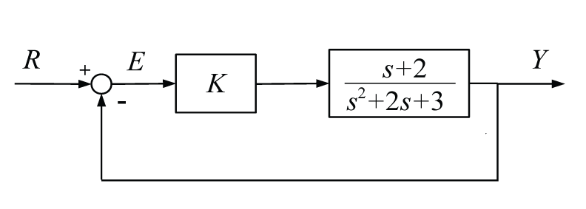
Example
Find K (if it exists) that provides a settle time for the following system of 4/3 seconds
Step 1: Translate specifications into pole locations

Slide 3
Example (continued)
Step 2: We found the root locus for this OL TF earlier
Step 3: Can this requirement be met?

Slide 4
Example (continued)
Determine the necessary value of K

Slide 5
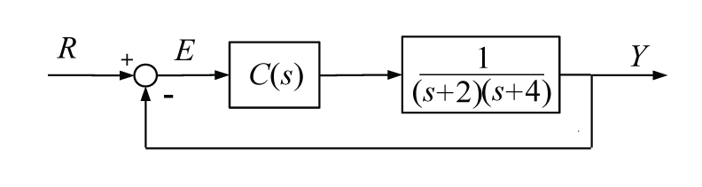
Example
Design C(s) that achieves a peak time less than 1 second and an overshoot less than 4%
Step 1: Plot desired region of closed-loop poles

Slide 6
Example (continued)
Im
Step 2: Plot root locus for C(s) = K
Step 3: Can requirements be met for this controller?
Re

Slide 7
Example (continued)
Attempt a PD controller
Can given requirements be met for this controller?
K_{D}
K_{P}

Slide 8
Example (continued)
Attempt a PI controller
Can given requirements be met for this controller?
K_{P}
K_{I}

Slide 9
Design via Root Locus
In general
Adding a zero tends to pull the root locus towards the left … tends to make system more stable, settle faster
Adding a pole tends to pull the root locus towards the right … tends to make system less stable, settle slower
Putting a pole near a zero or a zero near a pole tends to reduce their effect (like a pole-zero cancellation)

Slide 10
MATLAB Tools
http://ctms.engin.umich.edu/CTMS/index.php?example=Introduction&section=ControlRootLocus

